Slide 1



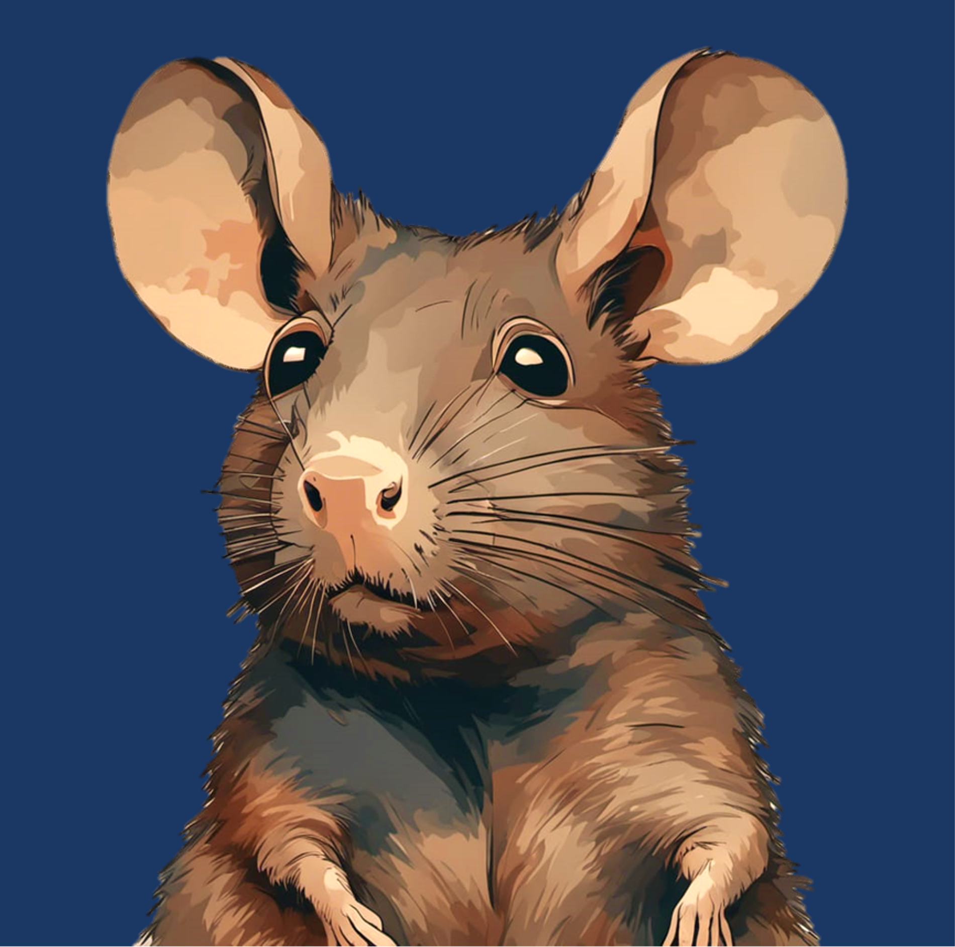



Slide 2
Notes:
The Restaurant Menu Dilemma: Imagine you're at a new restaurant, eager to try their delicious-sounding dishes. As you browse the menu, you're faced with a tough choice. Do you go for your favorite dish that you've had many times before, ensuring a satisfying meal but missing out on potential new flavors? Or do you take a risk and order something completely unfamiliar, hoping for a delightful surprise but knowing it might not live up to your expectations?
This simple restaurant scenario reflects the everyday decisions we make when confronted with uncertainty. We often weigh the comfort of the familiar against the excitement of the unknown. In your research, you can draw parallels between this common dining decision and the complex neural mechanisms at play when animals like Mongolian gerbils must decide between exploiting a known resource and exploring the uncertain possibilities of a changing environment.

Slide 6
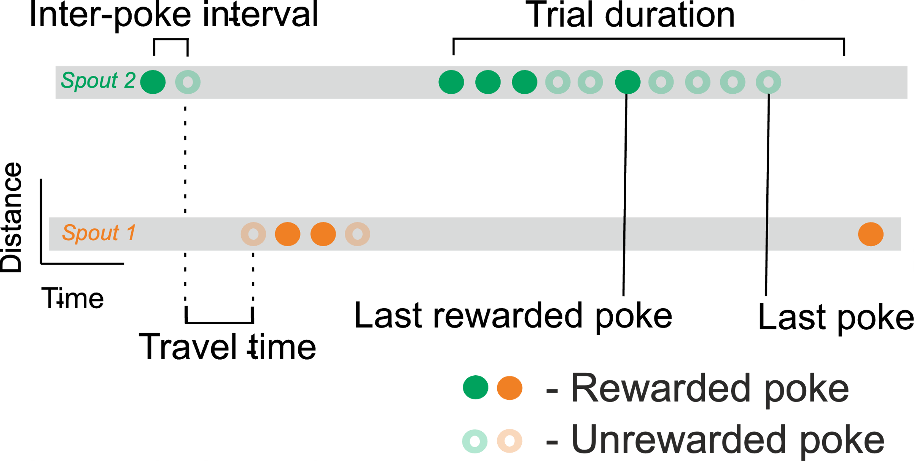

Slide 8
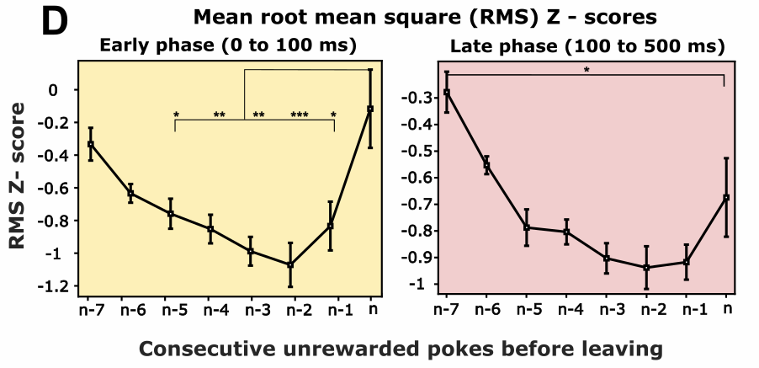
Overall cortical activity

Slide 13
Thank you
?
Questions are welcome

